Slide 1



INCENTIVES

Slide 2
2%

Slide 3
+

Slide 4
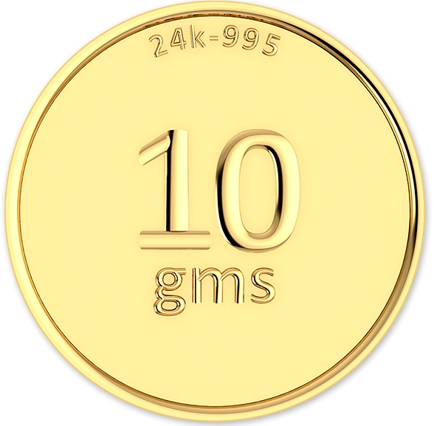
Pure Gold

Slide 5
2%
+
Pure Gold

Slide 6
ONLY FOR
BOOKINGS MADE
UPTO 31-12-2022

Slide 7
How to send lead to us ?
Visit www.modiproperties.com
Click Estate Agent
Enter customer details
Submit

Slide 8
Terms & Conditions:
Only broker/estate agents/channel partner who have a valid letter of appointment are eligible for brokerage commission.
Brokerage shall be 2% of the net sale consideration. However, this may vary based on other arrangements agreed with the Broker/Channel Partner/ Estate Agent.
A sum of Rs. 10,000/- shall be paid to you, within 7 days of the customer signing the agreement of sale. The balance brokerage shall be paid to you (after deducting TDS), within 15 days of receiving 40% of total sale consideration from the customer for their flat /villa (T & C shall apply).
Brokerage shall be paid for customers introduced by you only if the sale is closed within 3 months from this date.

Slide 9
Signup!

Slide 10
Get letter for authorised channel partner!

Slide 11
Thank You!

