Slide 1


www.modiproperties.com

Slide 2

About Modi Properties
Modi Properties is in the field of real estate development for over 4 decades.
Primary focus is on middle income housing in peripheral areas of Hyderabad.
Now expanding to tier III cities in Telangana.
Recently started low income housing around ORR – 50 kms radius.

Slide 3
Type of Development
Projects are designed to provide a great life style product to its customers.
Most projects are gated communities with modern amenities like clubhouse and swimming pool.
Gated communities are designed to control environment around flats/villas.
Focused on providing affordable quality housing.

Slide 4
Promoters Track Record
Promotors Track Record
35+ Years Track Record.
15+ Lakh sft construction completed.
20+ Projects successfully completed.
100+ Shops & Offices completed.
100+ Bungalows completed.
1,000+ Flats completed.
40⁺ years experience.
4⁺ million sft of construction completed.
3,500⁺ homes completed.
2⁺ million sft under construction.
1,000⁺ homes under construction.

Slide 5

Current Projects

Slide 6
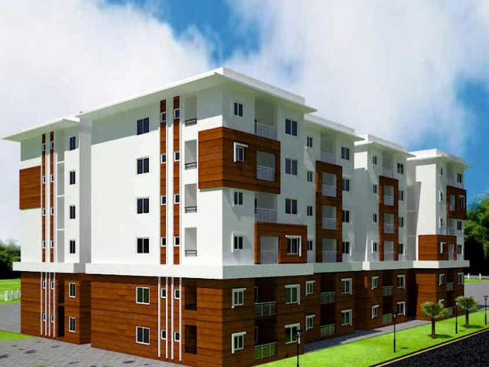
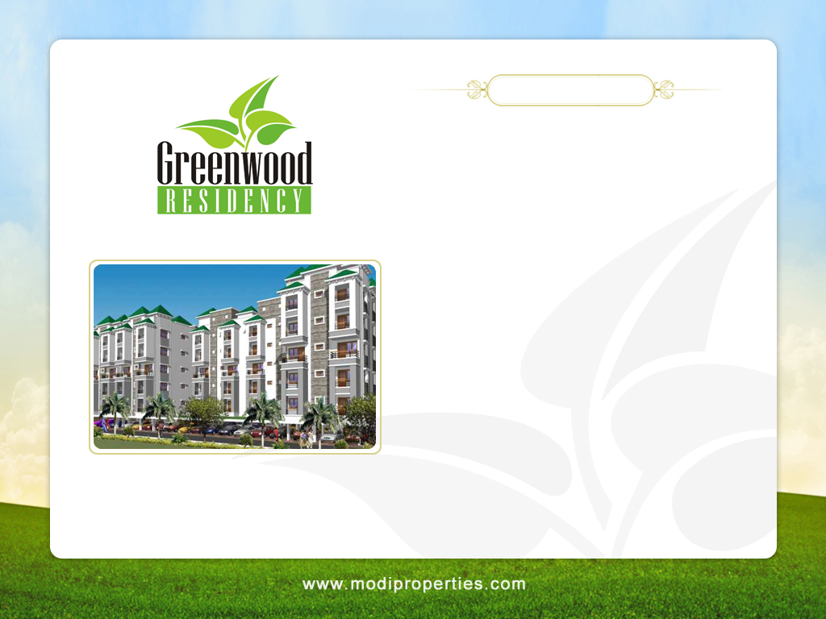


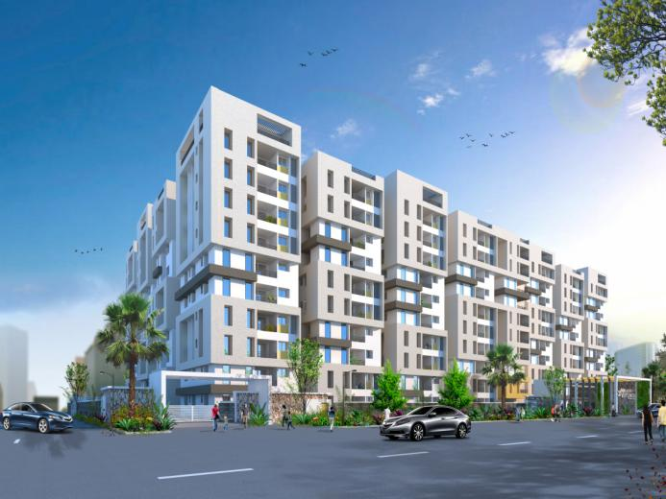
Features
345 flats on 6 acres.
2 & 3 bedroom flats from 1,100 & 1,665 sft.
Club House with, Gym, Recreation Room, Banquet Hall, Crèche, Library.
Swimming Pool.
Tennis, Badminton & Basketball Courts.
1 acre Central Landscaped Park.
Possession from Dec.’09.
Mayflower Platinum
189 flats on 2.3 acres,
Mallapur, Hyderabad.
Completion - 2022
Gulmohar Residency
354 flats on 8 acres,
Mallapur, Hyderabad.
Completion - 2023

Slide 7


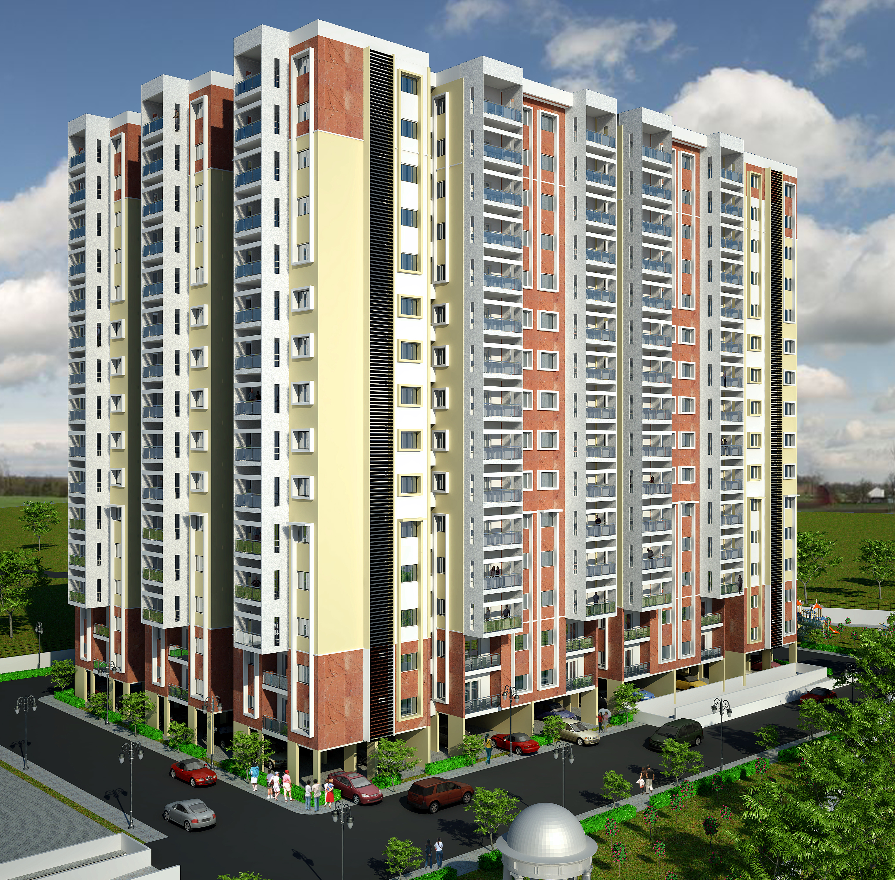
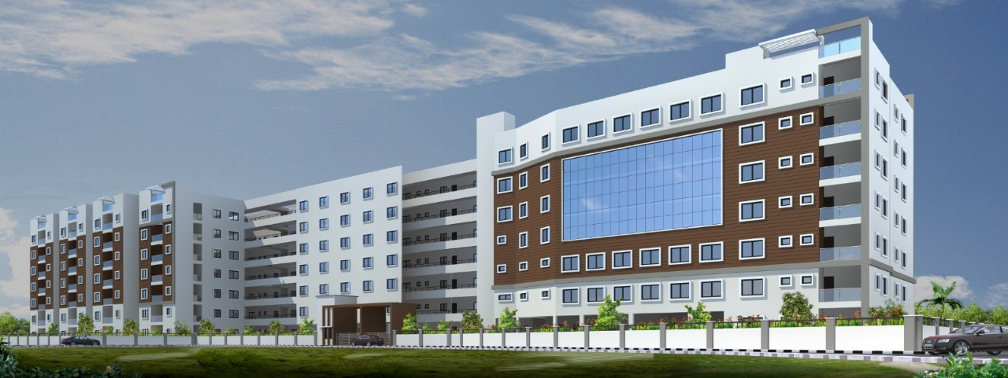
Features
345 flats on 6 acres.
2 & 3 bedroom flats from 1,100 & 1,665 sft.
Club House with, Gym, Recreation Room, Banquet Hall, Crèche, Library.
Swimming Pool.
Tennis, Badminton & Basketball Courts.
1 acre Central Landscaped Park.
Possession from Dec.’09.
East Side Residency
750 flats on 6 acres.
Pocharam, Hyderabad.
Completion - 2022
Greenwood Heights
119 flats on 2 acres,
Kowkur, Secunderabad.
Completion - 2022

Slide 8


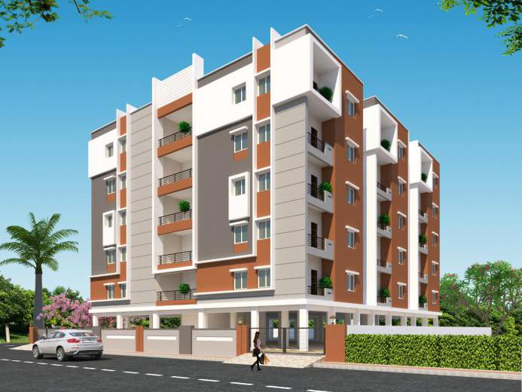
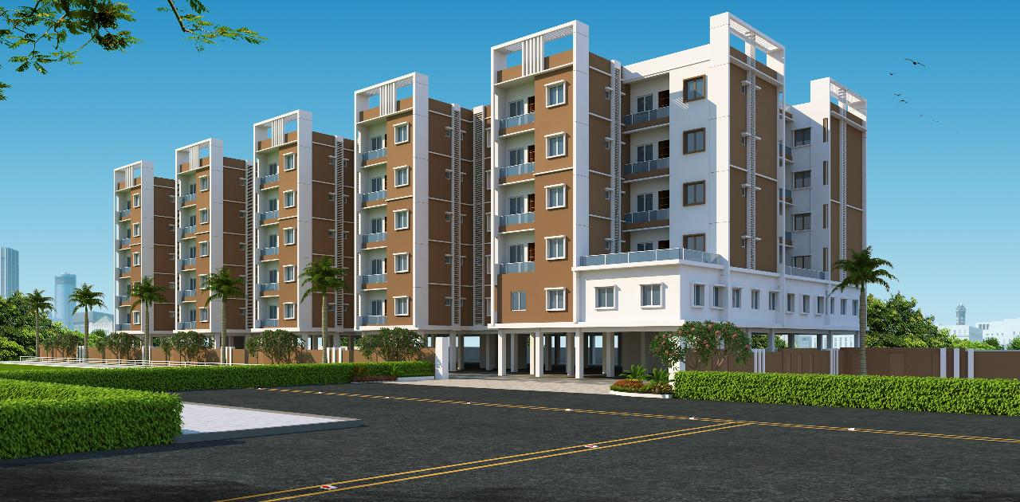
Features
345 flats on 6 acres.
2 & 3 bedroom flats from 1,100 & 1,665 sft.
Club House with, Gym, Recreation Room, Banquet Hall, Crèche, Library.
Swimming Pool.
Tennis, Badminton & Basketball Courts.
1 acre Central Landscaped Park.
Possession from Dec.’09.
Morning Glory Apartments
30 flats on 1,122 sq yds.
Genome Valley, Hyderabad.
Completion - 2020
Bloomdale Residency at Genome Valley
107 flats on 1 acres,
Near Shamirpet, Hyderabad.
Completion - 2022

Slide 9


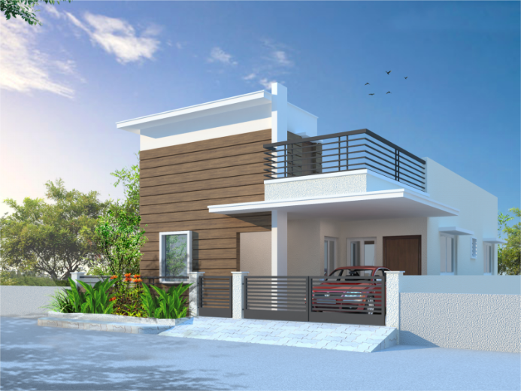
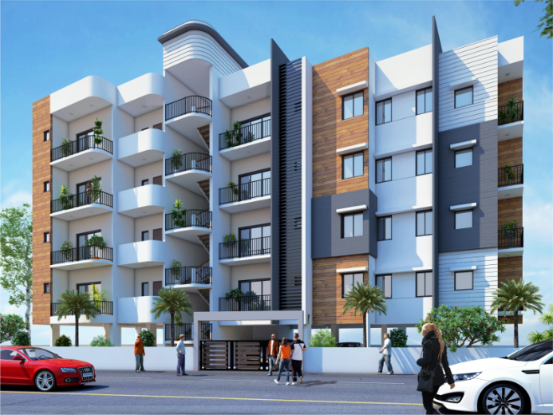
Features
345 flats on 6 acres.
2 & 3 bedroom flats from 1,100 & 1,665 sft.
Club House with, Gym, Recreation Room, Banquet Hall, Crèche, Library.
Swimming Pool.
Tennis, Badminton & Basketball Courts.
1 acre Central Landscaped Park.
Possession from Dec.’09.
Silver Oak Villas - Phase III
114 villas on 7.5 acres,
Cherlapally, Hyderabad.
Completion - 2021
Silver Oak Residency
8 flats on 600 sq yds,
Cherlapally, Hyderabad.
Completion - 2020

Slide 10


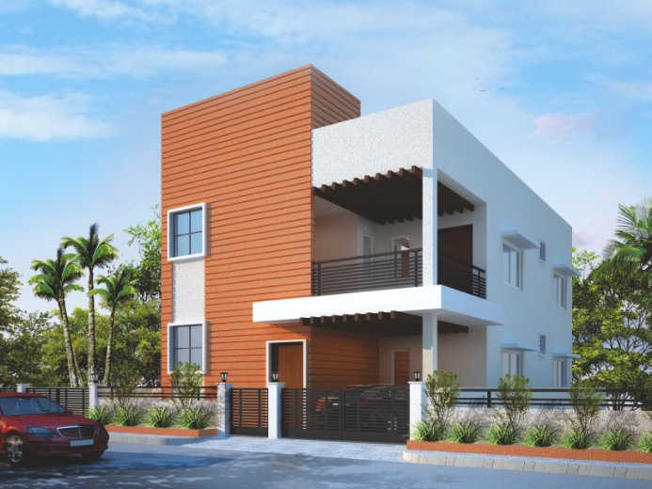
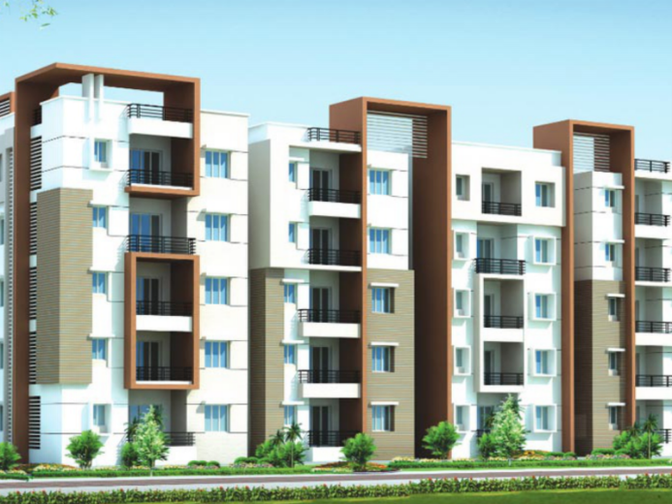
Features
345 flats on 6 acres.
2 & 3 bedroom flats from 1,100 & 1,665 sft.
Club House with, Gym, Recreation Room, Banquet Hall, Crèche, Library.
Swimming Pool.
Tennis, Badminton & Basketball Courts.
1 acre Central Landscaped Park.
Possession from Dec.’09.
AVR Gulmohar Homes
91 villas on 6.5 acres,
Miryalaguda, Telangana.
Completion - 2020
Vista Homes
403 flats on 5.65 acres,
Kapra, Hyderabad.
Completion - 2020

Slide 11


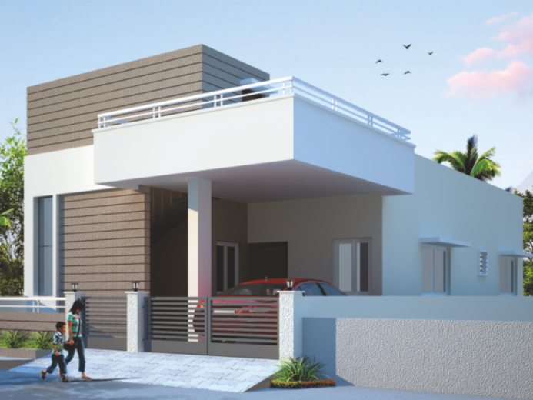
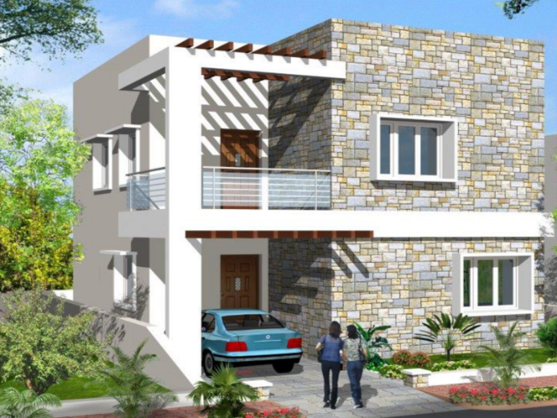
Features
345 flats on 6 acres.
2 & 3 bedroom flats from 1,100 & 1,665 sft.
Club House with, Gym, Recreation Room, Banquet Hall, Crèche, Library.
Swimming Pool.
Tennis, Badminton & Basketball Courts.
1 acre Central Landscaped Park.
Possession from Dec.’09.
Nilgiri Estates
188 villas on 10 acres,
Rampally, Hyderabad.
Completion - 2020
Bloomdale
72 villas on 5 acres,
Shamirpet, Hyderabad.
Completion - 2020

Slide 12


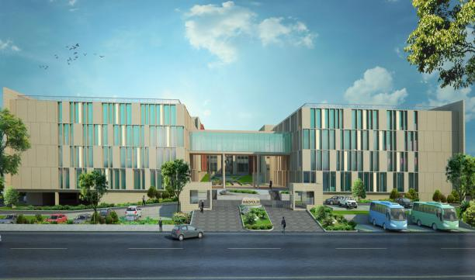
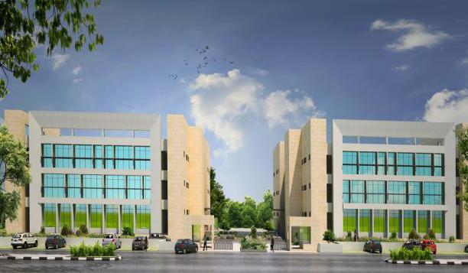
Current Projects - Commercial
Innopolis
6 lakh sft lab space for life sciences on 9.20 acres.
Genome Valley, Hyderabad.
Completion - 2022
Colabs
1 lakh sft lab space for life sciences on 2.25 acres.
Genome Valley, Hyderabad.
Completion - 2021

Slide 13

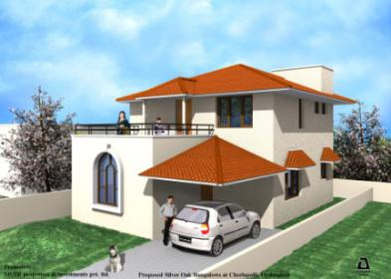
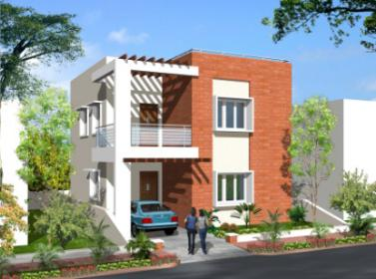
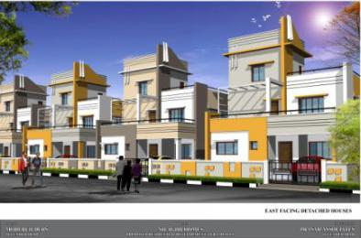
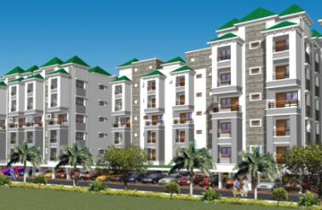
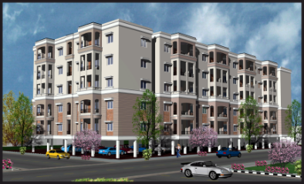
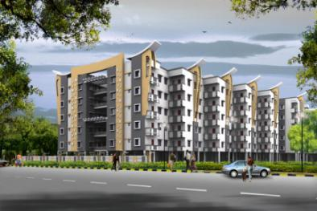
Completed Projects
Silver Oak Bungalows
Phase I, II, & III
250 villas on 25 acres,
Cherlapally, Hyderabad.
Villas at Silver Creek
54 villas on 3 acres, Nagaram, Hyderabad.
Nilgiri Homes
95 villas on 6.5 acres,
Rampally, Hyderabad.
Greenwood Residency
345 flats on 6.10 acres,
Kowkur, Hyderabad.
Gulmohar Gardens – Phase I & II
505 flats on 5 acres, Mallapur, Hyderabad.
Mayflower Heights
280 flats on 4 acres,
Mallapur, Hyderabad.

Slide 14
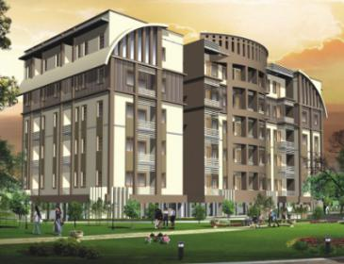
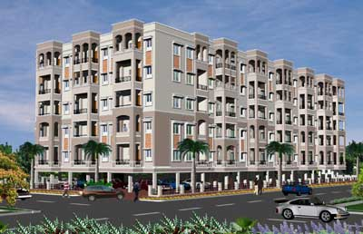
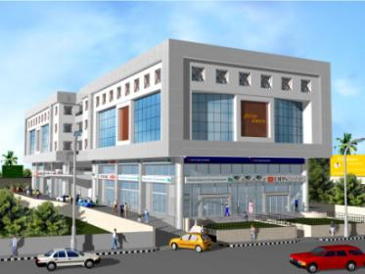
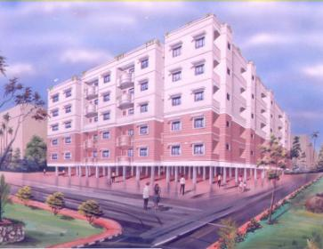
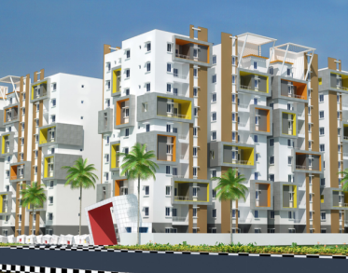
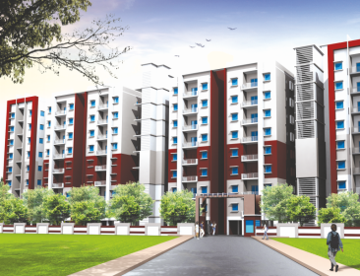
Completed Projects
Paramount Residency
260 flats on 3.10 acres,
Nagaram, Hyderabad.
Silver Oak Apartments
120 flats on 1 acre, Cherlapally, Hyderabad.
Greens Towers
80,000 sft office space, Begumpet, Hyderabad.
Mayflower Park
545 flats on 5.5 acres, Mallapur, Hyderabad.
Mayflower Grande
370 flats on 3 acres,
Mallapur, Hyderabad.
Paramount Avenue
208 flats on 2 acres, Nagaram, Hyderabad.

Slide 15
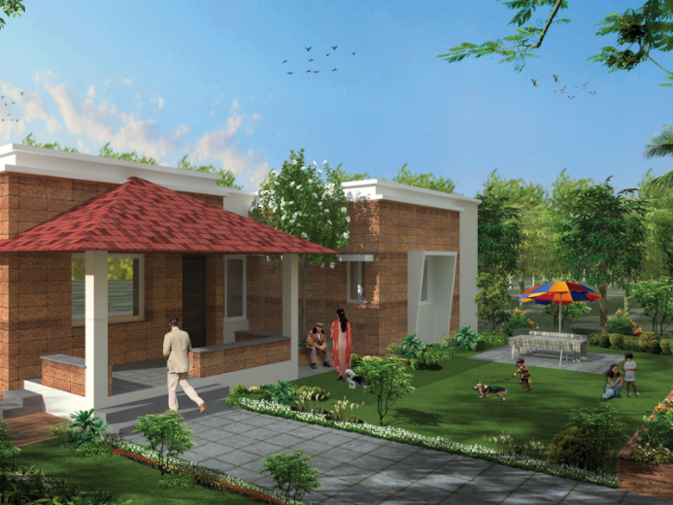
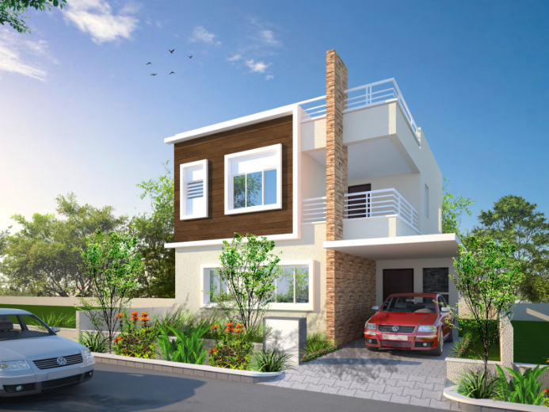
Completed Projects
Serene Farms
50 farm houses on 32 acres,
Chevella, Hyderabad.
Villa Orchids
340 villas on 21 acres,
Nagaram, Hyderabad.
Silver Oak Villas - Phase I & II
95 villas on 6.5 acres,
Cherlapally, Hyderabad.

Slide 16
Proposed Projects
May Flower Homes
145 villas on 10 acres, Dundigal, Hyderabad.
Bloomdale Villas at Genome Vallaey
120 villas on 6.75 acres, Genome Valley, Hyderabad.
Nilgiri Heights
270 flats on 2.5 acres, Pocharam, Hyderabad.
Marrigold Residency
180 flats on 2 acres, Kompally, Hyderabad.
(Land acquired or JDA signed)

Slide 17
Proposed Projects
Bluebell Residency
110 flats on 1 acre, Vikarabad, Telangana.
Manilal Modi Memorial Hospital
75 bed, 45,000 sft hospital on 0.50 acre, Genome Valley, Hyderabad.
Innopolis North Point
2 lakh sft lab space for life sciences on 4.25 acres.
(Land acquired or JDAsigned)

Slide 18
USP – Unique Selling Point
Till date all projects were completed on time.
Short delivery period – typically less than 1 to 2 years.
Affordable quality construction with excellent amenities.
Projects located in virgin areas with high latent demand.
Unit sizes and rates are tuned to affordability of customers in the area.

Slide 19
Ethics & Transparency
All projects RERA complaint for over 2 decades.
Completion dates for each unit declared up front.
Draft agreements, prices & availability status readily available on website.
Access to information about projects through website.

Slide 20

Contact Us
Head office:
Modi Properties Pvt. Ltd.
5-4-187/3 & 4, II floor, Soham Mansion,
M G Road, Secunderabad 500 003
Phone: +91- 40- 6633 5551
Email: info@modiproperties.com
Website: www.modiproperties.com

Slide 21
Thank You

